Slide 1

Tagging rules

Slide 2
High-quality training Data Set
is a key to successful cognitive automation.
In order to achieve this, DA works closely with SMEs (Subject Matter Experts) from the customer's side to ensures it’s good to be delivered to the model.
SMEs are people on the client's side who:
are high specialists and well familiar with the documents,
know the meaning of each field,
provide DA information that helps to understand business case;
can provide information whether documents are well-structured or not,
can explain any kind of additional logic regarding what should be extracted and why.

Slide 3
Plan on Work
Use case study
Training
Qualification
Tagging
Use-case study. DA needs to study documents, their types and fields logic that WF is going to work with.
Training. DA provides training about Data Set requirements, WorkSpace application and how to tag documents correctly
Qualification is performed to verify that there is correct understanding for the SMEs team how to work with the system and what should be tagged.
Tagging in Manual task is used to transform documents’ information into a Data Set for machine learning.

Slide 4
WorkSpace

Slide 5
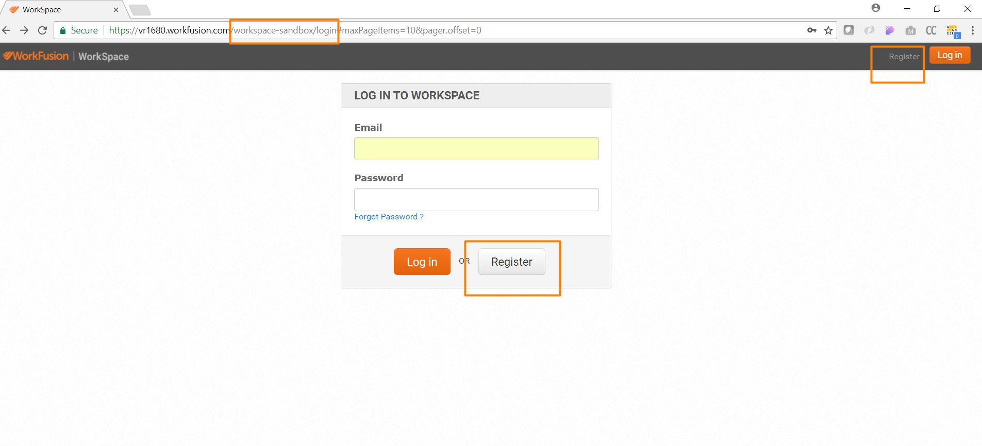
Download the link to sandbox
Click register button
How to register in WorkSpace

Slide 6
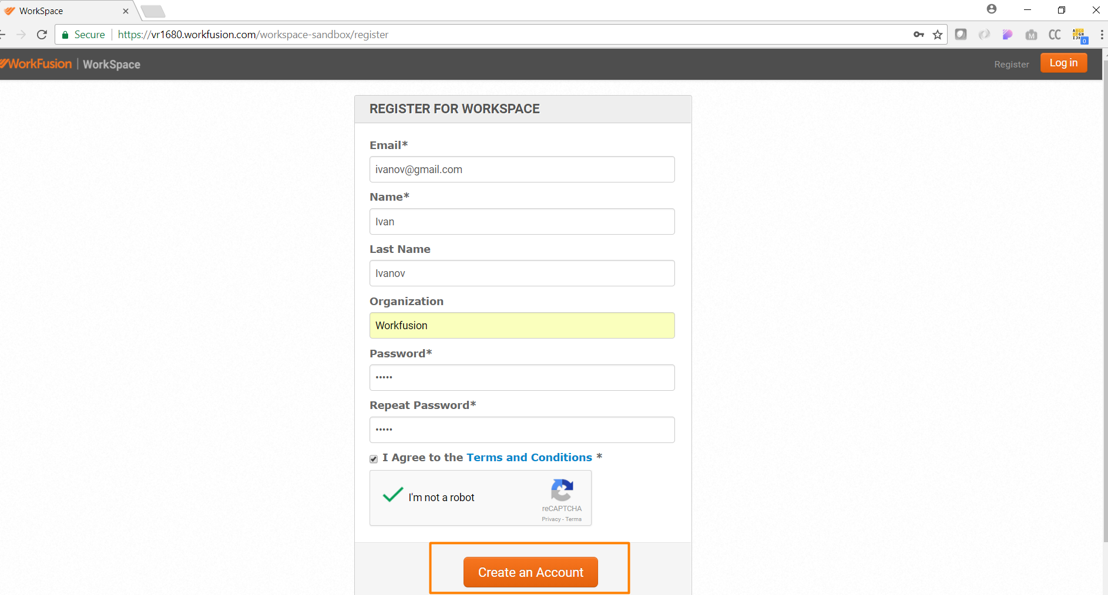
Fill the form and click “Create an Account”

Slide 7
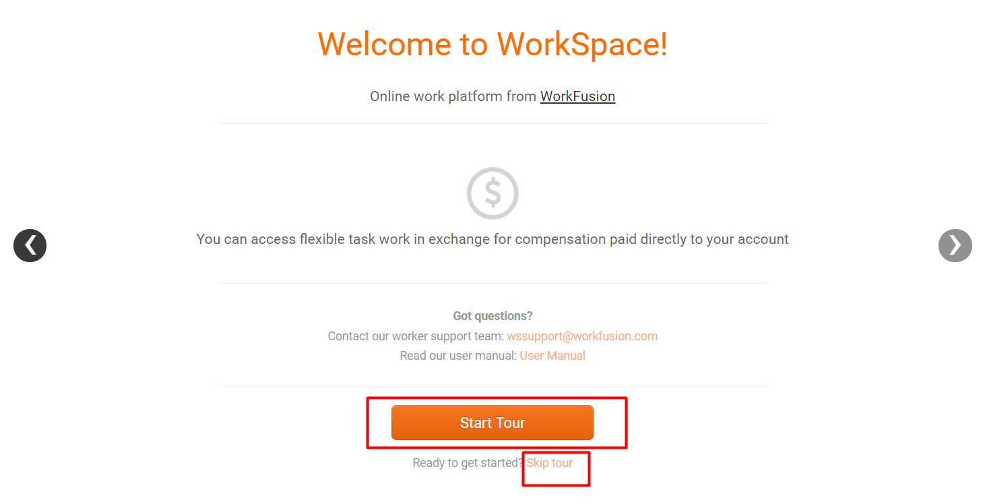
Look through the “Welcome” pop-up window and start tour, if needed, or skip it.

Slide 8
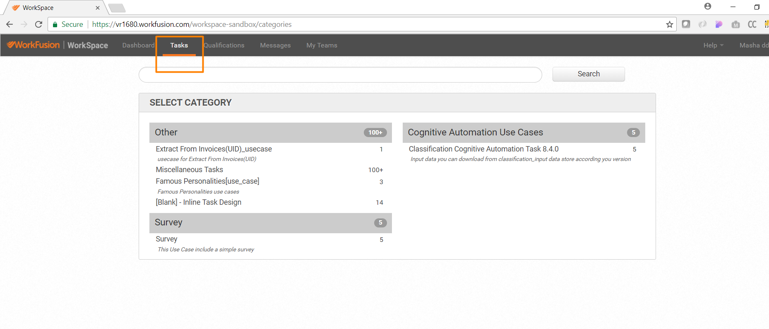
Select “Tasks” tab and required category to view the list of available tasks

Slide 9
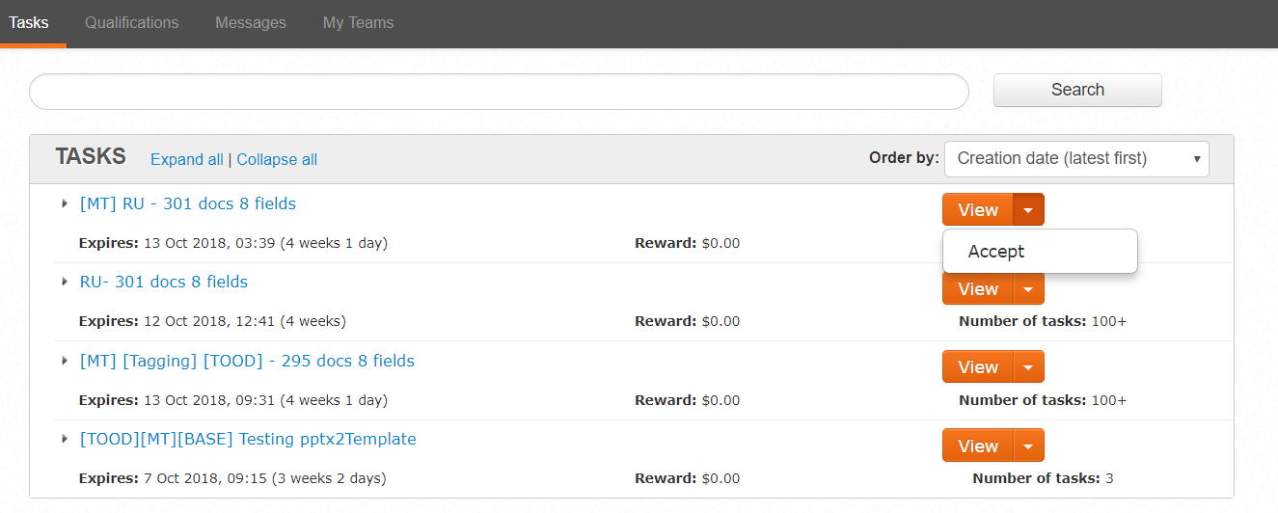
Once you found your task, click on the arrow as on the picture and accept it

Slide 10
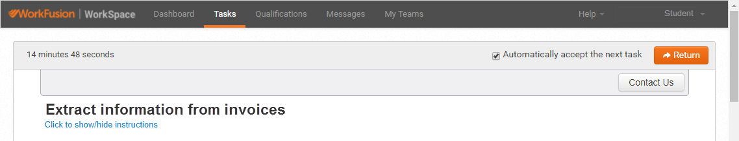
In order to save the time while tagging, put a tick near “Automatically accept the next task” statement.
If you can not perform the tagging of a certain document, click on “Return” button.
Note that this document will return to the pool in a few minutes and will become available for tagging again.

Slide 11
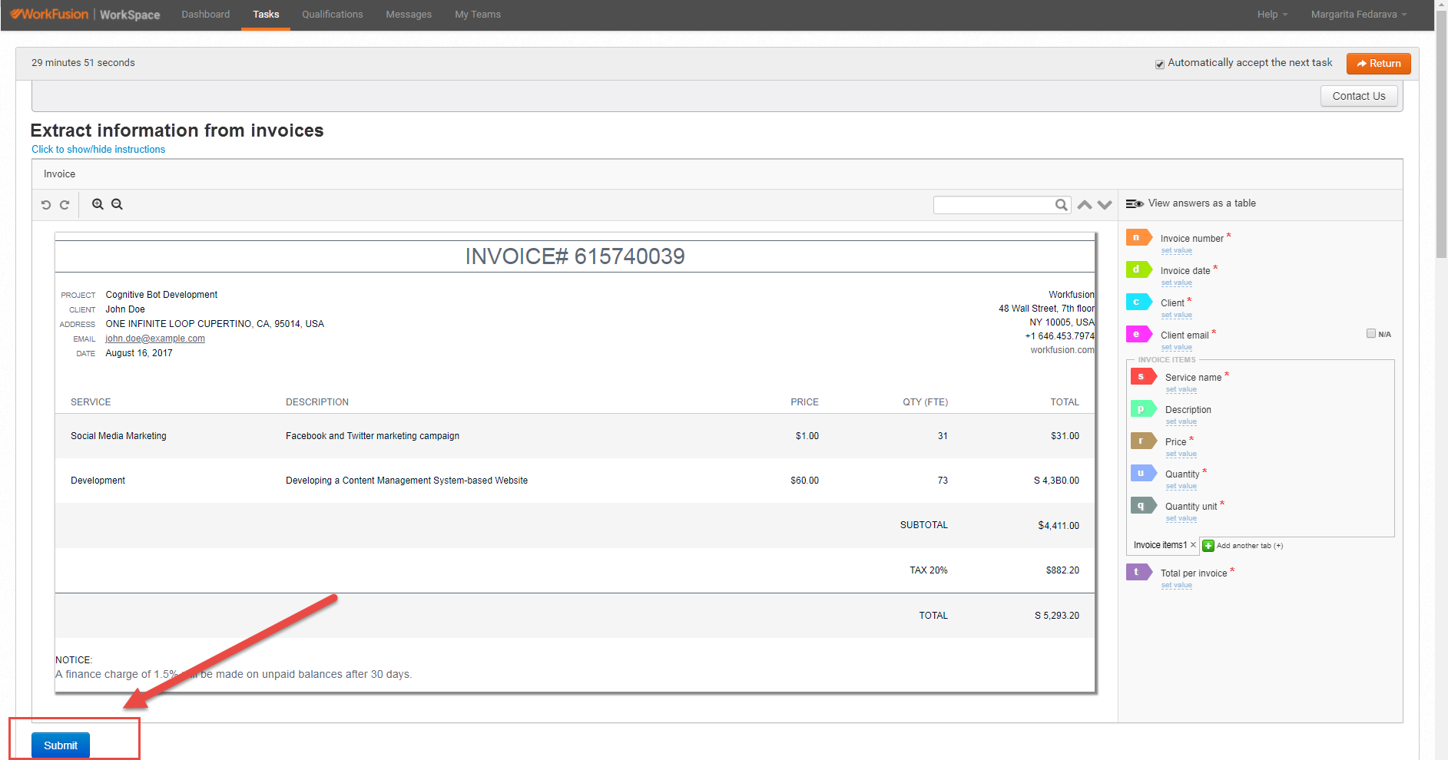
Once the tagging is done, please,
click on “Submit” button in the bottom of the page.

Slide 12
User Guide for Tagging
https://s3.amazonaws.com/pub_demo/ie-help/index.html

Slide 13
Some tips to remember
Click on the word 2 times to highlight it
For multiple selection use Ctrl + click | drag (make sure it doesn’t highlight/cover other values)
You can use Ctrl+click to select the whole cell or several cells.

Slide 14
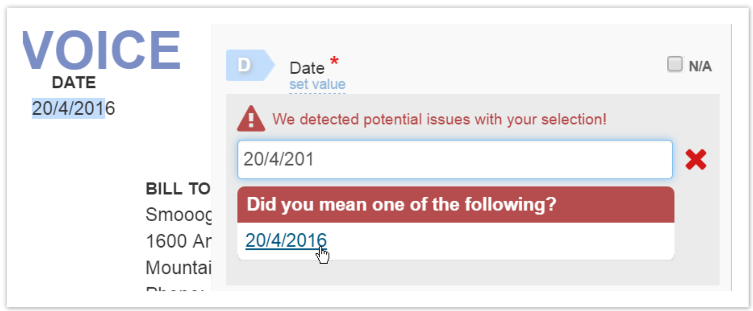
Auto Corrections (1/2)
When a Worker has selected only a part of a word, number, or phrase the WorkFusion engine analyses this situation and automatically suggests corrections depending on the context. If you agree with the proposed value, just select it.

Slide 15
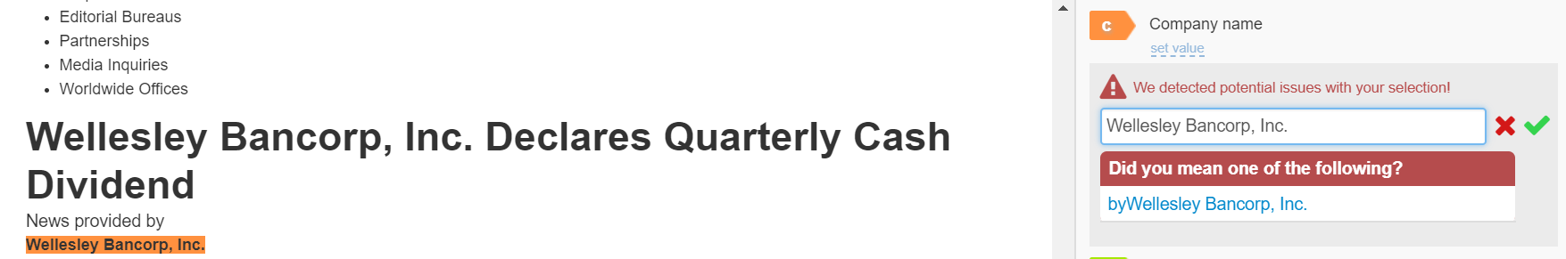
Auto Corrections (2/2)
Sometimes autocorrection may propose an odd part of data, for example, prepositions or numbers included in closely situated tags. Please be careful and do not accept such a correction.

Slide 16
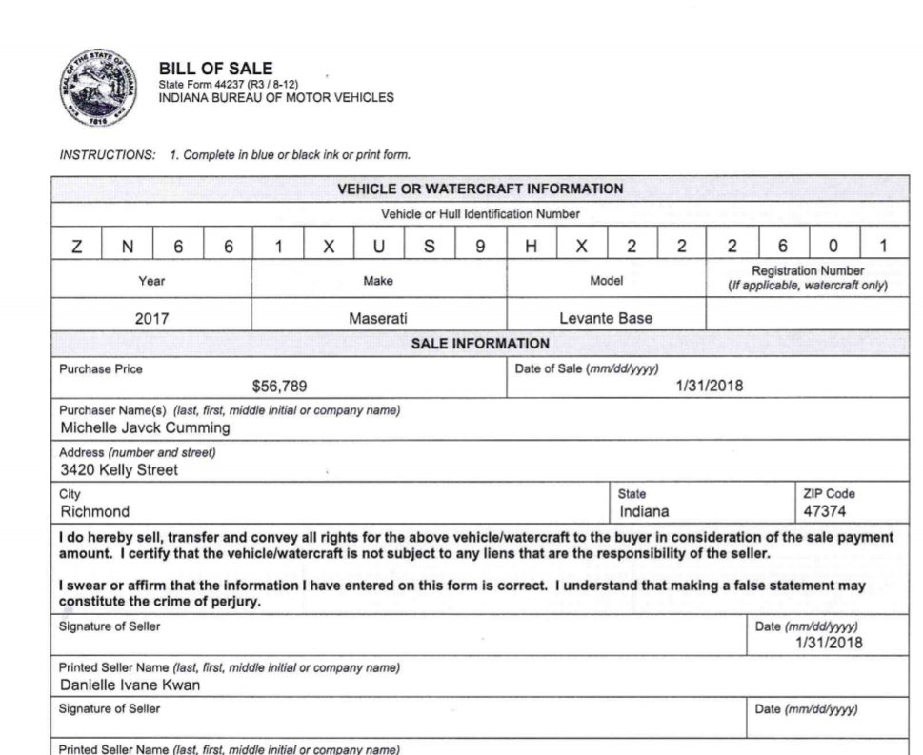
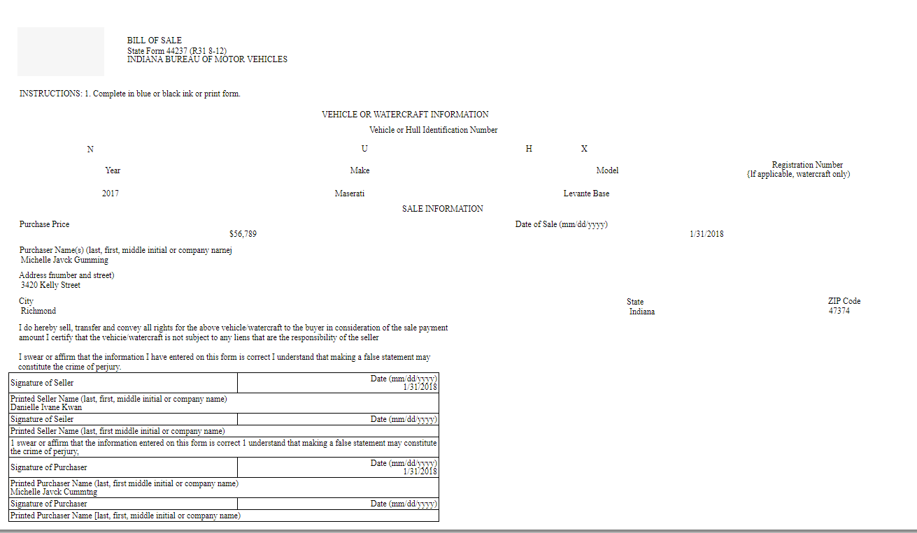
OCR
In our process we OCR a document before it gets to classification and extraction tasks. As a result of OCR we get html document viewable in WorkFusion Manual Task tool.
PDF -> OCR process (optical character recognition) -> html
PDF
html file
OCR

Slide 17
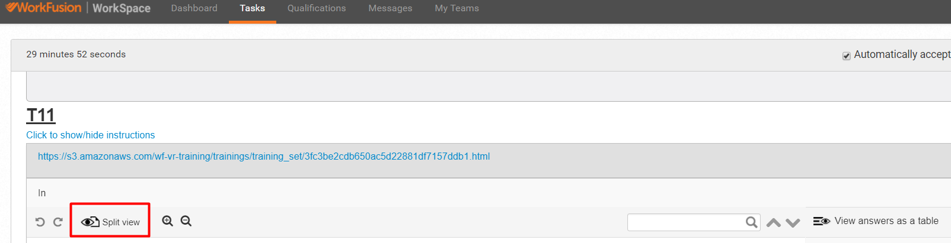
OCR correction
In case of OCR mistakes values should be corrected manually, for example:
Invoice after OCR contains 1b7OO for the field “Total amount”.
But we know that total amount can’t contain letters.
Therefore we should check original document and manually correct the value 1b7OO into 16700 while tagging.
You can view original document by clicking “Split view” button
Bad OCR quality (when you can’t make out anything in the document) should be reported!

Slide 18
Main principles in tagging

Slide 19
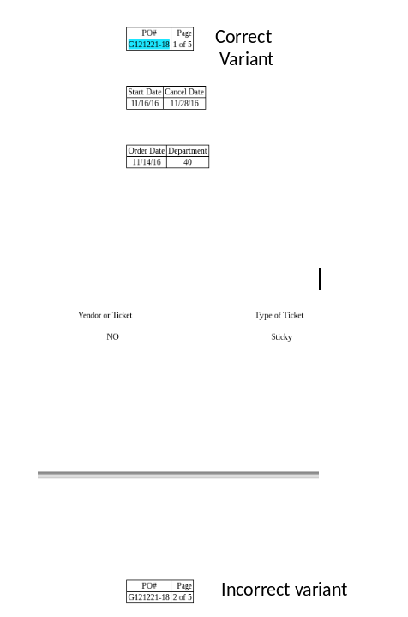
Consistency
2-
  Each field should be consistently tagged across a certain layout:
  for example, if an invoice has the same "po_number" occurring on all the pages of the document, we should always label the one at the same location (on the same one page across all the data set; for example, on the first page).
  Otherwise, it will send a confused signal to Machine Learning algorithm

Slide 20
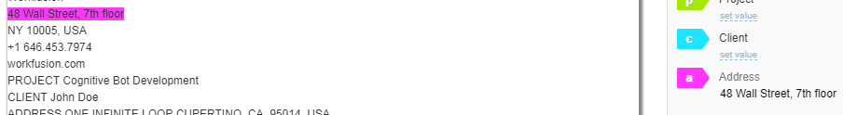
Completion
  If correct field is given in the document, it must be tagged. Do not miss values
  If a field contains multiple words, we should always label the entire string (with all the words) belonging to the field.
  Example: address
  o extract rest of the fields

Slide 21
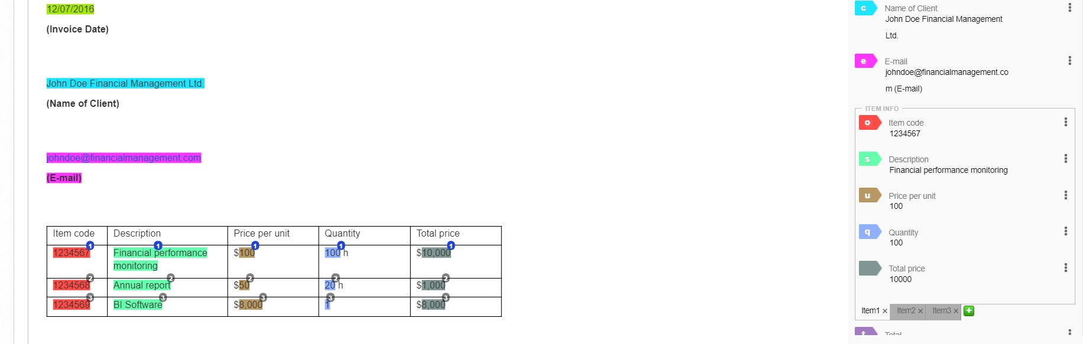
Typical Cases of Incorrect Tagging
1 - Extra data was tagged
Tag “E-mail” contains phrase (E-mail) which doesn’t relate to the tag

Slide 22
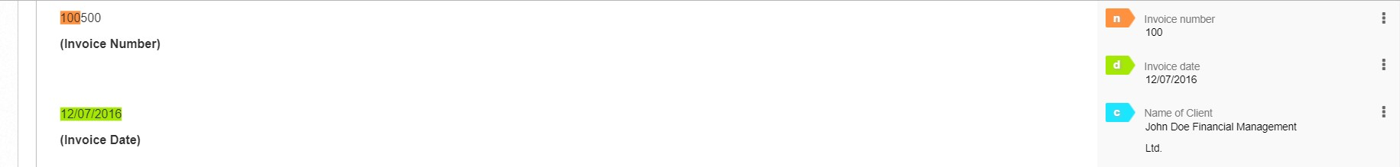
Typical Cases of Incorrect Tagging
2 - Not complete data was tagged
Tag “Invoice number” doesn’t contain full information from the required field.

Slide 23
Thank you

